Slide 1
RADICAL AI GEMINI quizzify project
BY VEDANTH AGGARWAL
Project : RAG POWERED LLM QUIZ APPLICATION FOR KAI EDUCATION ASSISTANT

Slide 2
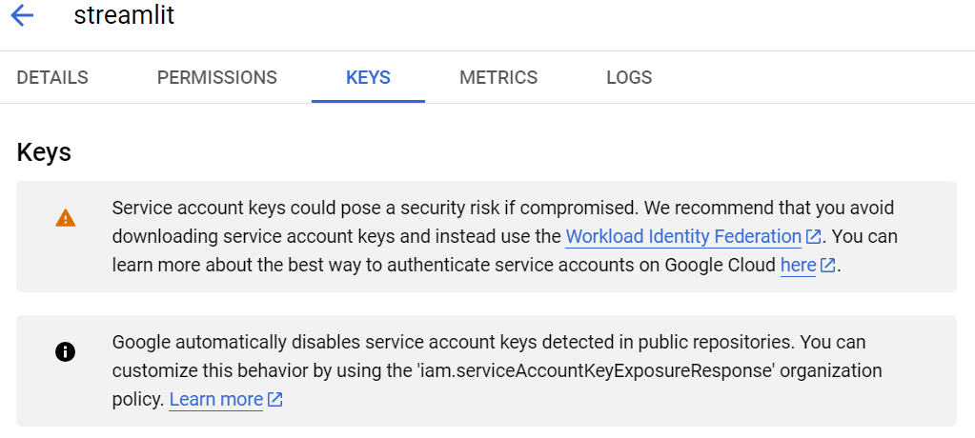

Slide 3
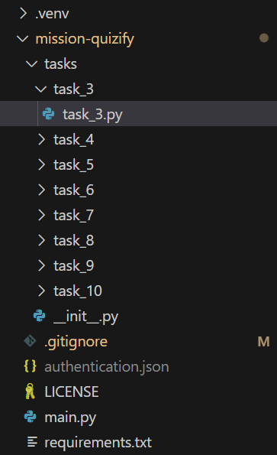

Slide 4
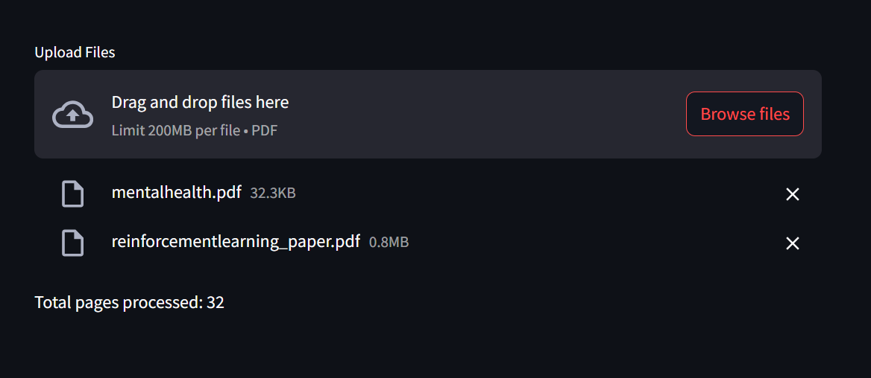

Slide 5
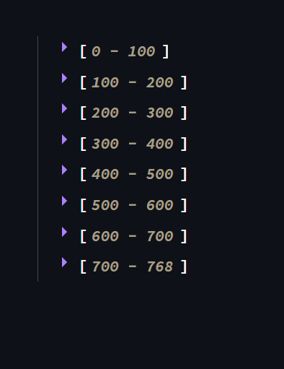

Slide 6
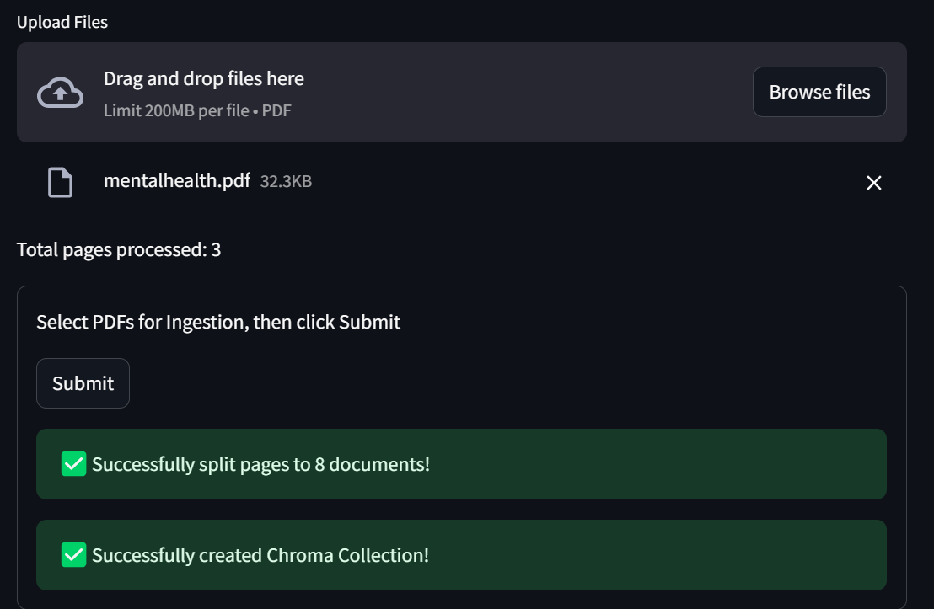

Slide 7
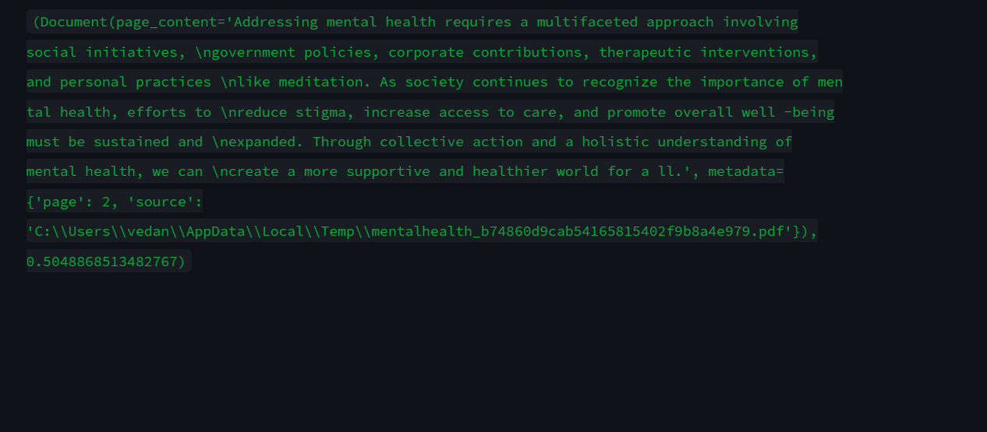

Slide 8
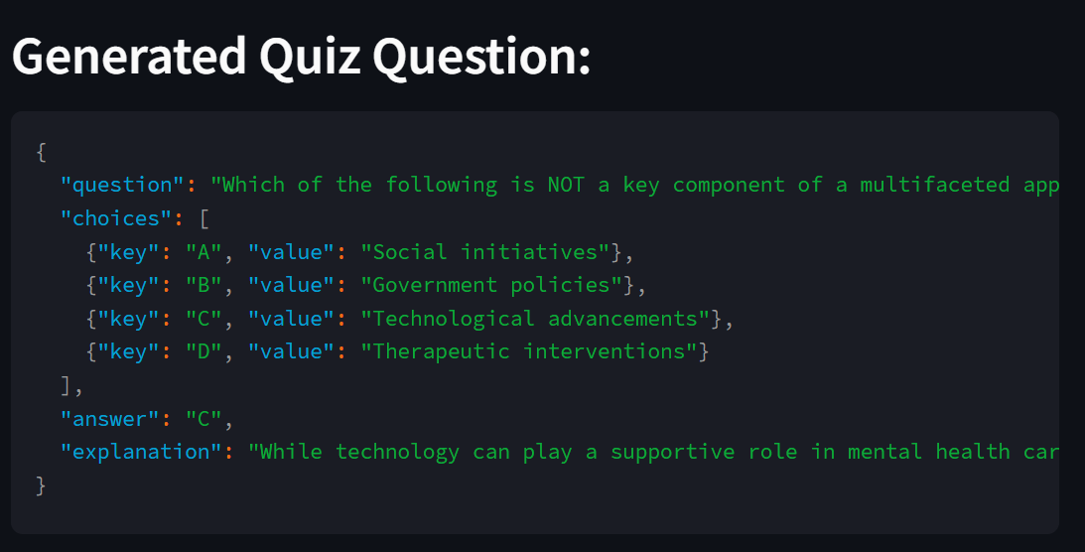

Slide 9
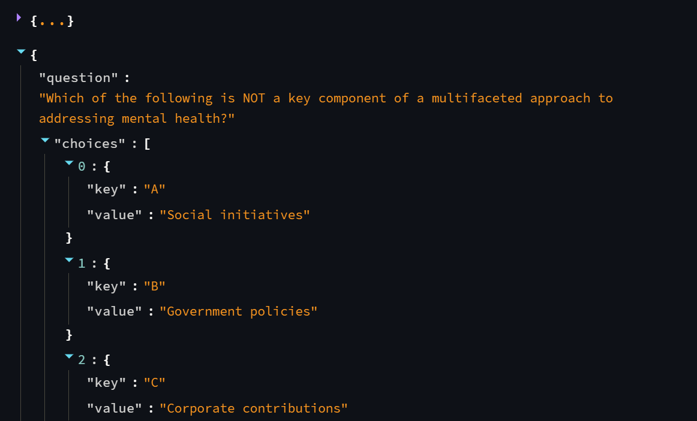

Slide 10
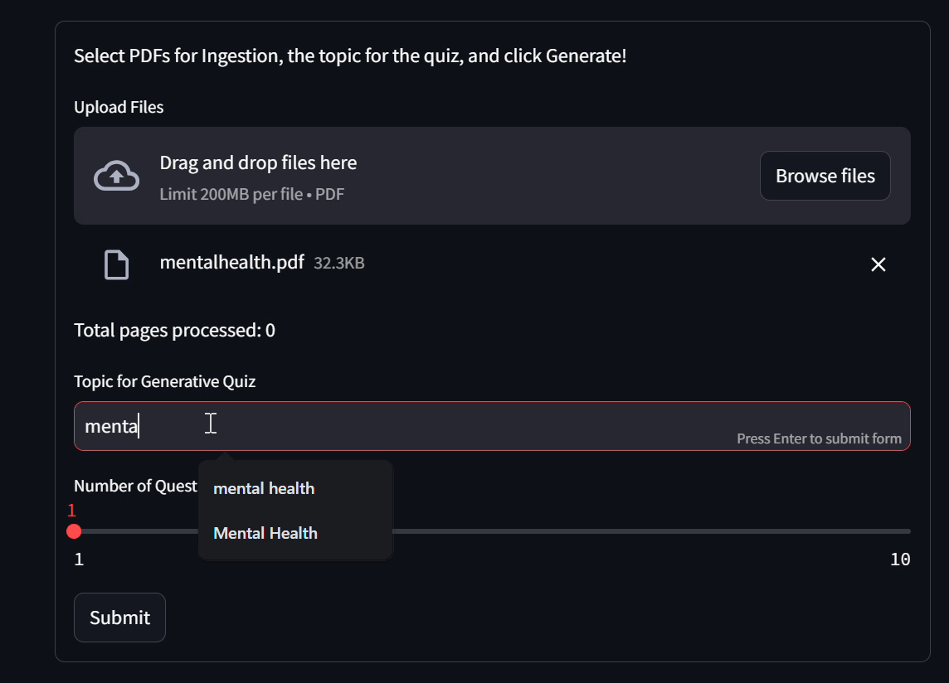
VIDEO DEMO

Slide 11
RADICAL AI GEMINI quizzify project
BY VEDANTH AGGARWAL
Project : RAG POWERED LLM QUIZ APPLICATION FOR KAI EDUCATION ASSISTANT

